Slide 1

Reflexology Course 1
Heather Han, LMT, MSCP

Slide 2
Reflexology Course 1
Course Description: Students completing this course will be able to understand and discuss the theory and history of reflexology. They will learn the basic anatomy and physiology of the body and the locations of the corresponding reflex points on the feet and the various techniques to work them. Upon completion they will be able to give a full 1- hour reflexology session.

Slide 3
Class 1 Objectives
Introduces reflexology by understanding what it is, its benefits and how it works, how the reflex
points of the feet correspond to parts of the body and basic relaxation techniques
Orientation
Go over course Syllabus
What is Reflexology?
How does Reflexology work?
What are the benefits of Reflexology?
How does the body relate to the feet?
Learn Relaxation techniques

Slide 4
What is Reflexology?
A manual therapy focusing on reflex points of the hands, ears and feet that affects the whole body.
Pressure on the feet and hands affects all organs glands and parts of the body. Reflexology improves circulation of blood and energy and improves nerve transmission
How does Reflexology Work?

Slide 5
How does Reflexology Work?
Energy- affects flow of energy through body channels or zones
Circulation- affects flow of blood throughout the body
Nerves- affects flow of nerves that send signals to the body
Relaxation
rejuvenation
circulation
preventative healthcare
What are the Benefits of Reflexology?

Slide 6
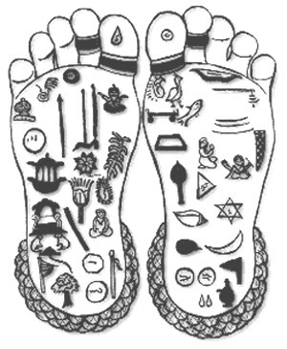
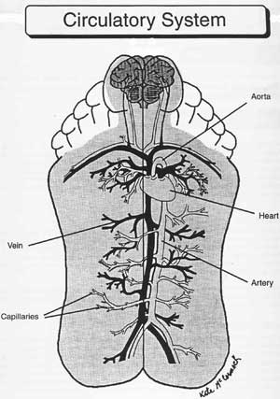
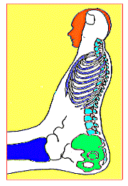
Feet, Hands and Ears as map of the body

Slide 7
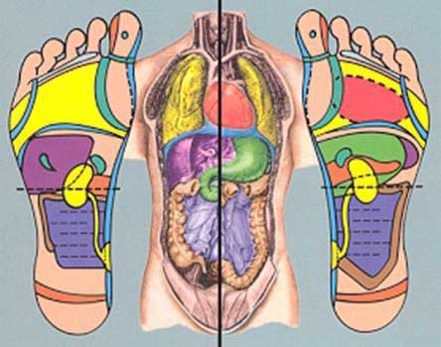
Feet, Hands and Ears as map of the body

Slide 8
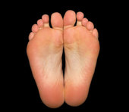
Identify Landmarks of the Feet
Base of toes- neck line
Diaphragm – below ball of foot
Waist- base of fifth metatarsal
Heel-pelvic line
Spine
5 zones on each foot

Slide 9
50- Point Chart

Slide 10
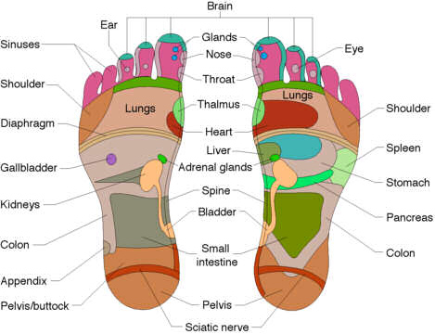

Slide 11
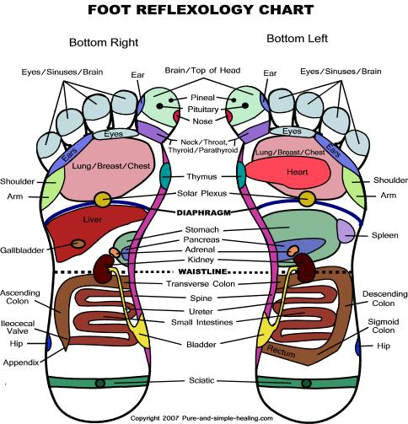

Slide 12
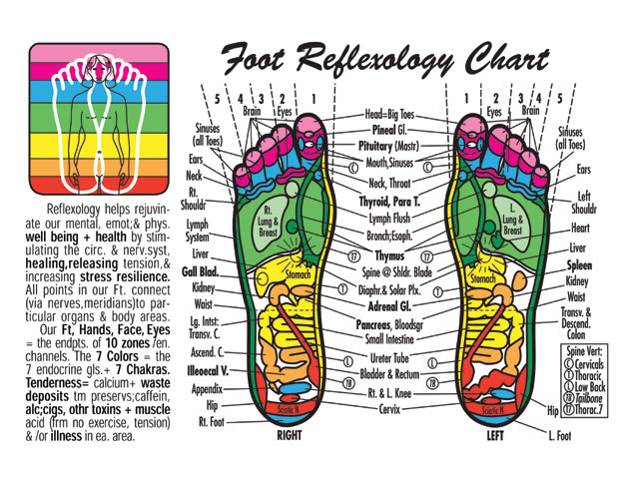

Slide 13
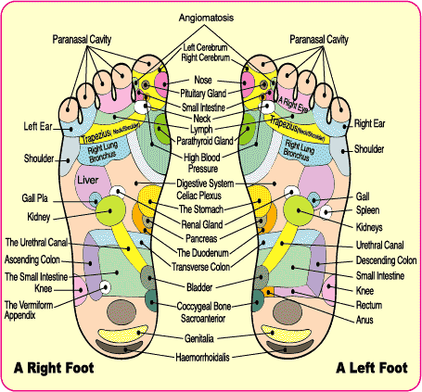

Slide 14
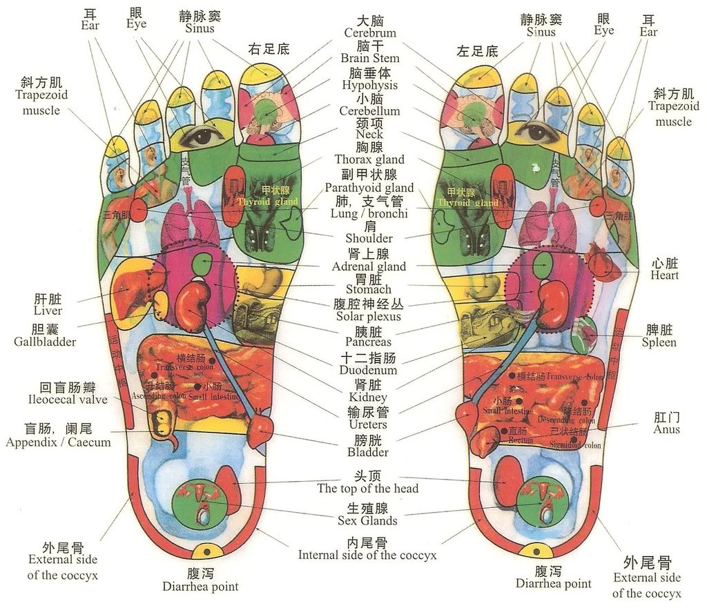

Slide 15
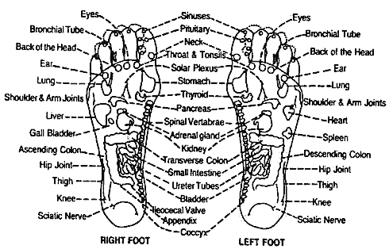

Slide 16
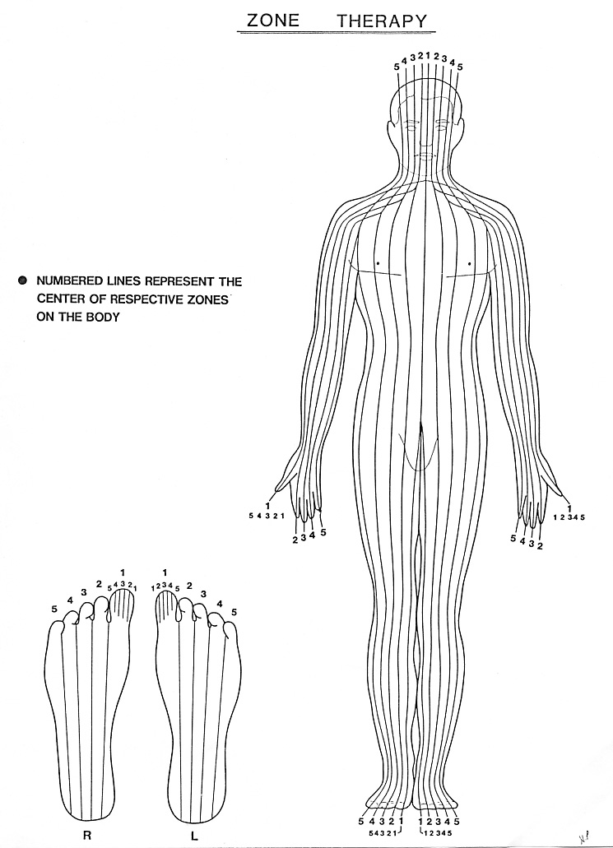
Zone Therapy
Zone therapy- what happens in one part of Zone it can affect any organ or gland in that Zone, viewed as simplified meridian system

Slide 17
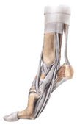
Reflexology Vocabulary
Metatarsal- Long bones of the feet
Dorsal- top surface of the foot
Plantar- Sole of the foot
Dorsiflexion- flexing the foot at the ankle
Medial- toward the midline of the body
Lateral- away from the midline of the body

Slide 18
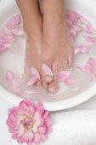
Foot Relaxation
Ankle range of motion – dorsiflexion, plantarflexion
Ankle rotation- hand on dorsal, hand on heel
Foot side to side shake
Ankle side to side shake
Toe side to side shake
Toe brush
toe rotation
Spinal Twist (medial)
Metatarsal press (plantar)
Metatarsal roll
Foot pinching (lateral)
Achilles tendon stretch
Diaphragm tension relaxer
Make it up- wringing circular friction, percussion,
nerve stroke

Slide 19

Techniques
Thumbwalking- most areas, primarily plantar
surface of the foot
Finger roll- brain- distal toe
Finger walk- dorsal foot
Hook in and pull back- pituitary, ileocecal valve, sigmoid flexure
Rotate- spine, diaphragm, lymph drain

Slide 20
Homework
Draw and label the horizontal and vertical guidelines on a foot
Practice relaxation techniques learned and record the clients reactions and your experience

Slide 21
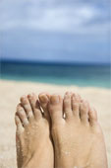
Class 2 Objectives
Review the history of reflexology
Current Reflexology Organizations
Contraindications for reflexology
Basic technique: Thumb walking

Slide 22
History of Reflexology
2330 BC- Wall painting in Egyptian Physicians tomb
Evidence of reflexology in China, Japan, India, Europe
Zone therapy discovered by physician in Boston who studied in Europe- used hands to treat
1917 “ Zone therapy, or Relieving Pain at Home” Dr William Fitzgerald
1919 “Zone Therapy Simplified” by Dr Joe Shelby Riley a colleague of William Fitzgerald
1938 “ the stories the feet can tell” Eunice Ingham- a physiotherapist at Dr Rileys office began mapping reflexes, known as founder of foot reflexology
1951 “ the stories the feet have told” Eunice Ingham
Nephew of Eunice Ingham, Dwyght Byers received relief from asthma and hay fever and is head of the International Institute of Reflexology
International Council of Reflexologists
Reflexology association of America

Slide 23
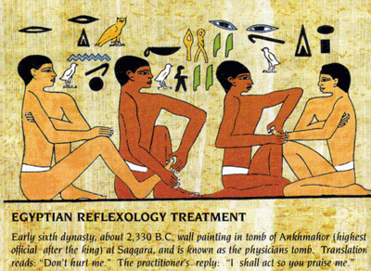

Slide 24
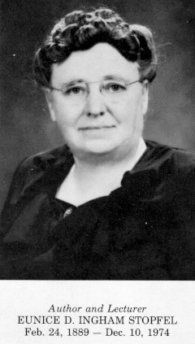
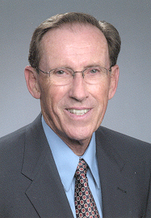
Eunice Ingham and Dwight Byers

Slide 25
Reflexology Associations
International Council of Reflexologists Liza Thomas, Membership Secretary
142 Edmonds Road,
Glenwood, Durban 4001
South Africa
Reflexology Association of America
375 North Stephanie Street
Suite 1411
Henderson, NV 89014
State Reflexology Associations
Reflexology Association of Hawaii (RAH)
465 Kapahulu Ave, Ste. 2A
Honolulu, HI 96815

Slide 26
Contraindications
Reflexology does not – diagnose, prescribe or treat for a specific illness
Do not claim to cure
Consider medical history – remembering it cant hurt anyone or make problem worse
For young old or sick- press lighter, shorter sessions, more frequently
Watch out for varicose veins, phebitis, gangrene, blood clots, osteoporosis, unstable pregnancy
Not contraindication for cancer, AIDs or other autoimmune disease
Monitor medication for possible reduction

Slide 27
Techniques
Thumbwalking- most areas, primarily plantar
surface of the foot
It inches forward not backward or side to side
Constant pressure applied with lateral edge of
the thumb
Thumb remains slightly bent while moving
forward
Support foot with holding hand

Slide 28
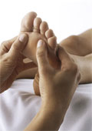
Homework
List 5 contraindications that are important to
consider when working with a client
Practice relaxation techniques and
thumbwalking and record the clients reactions
and your experience

Slide 29
Class 3 Objectives
Review treatment guidelines
Reflexology Techniques: finger walk, finger rolling, hook in and pull back
Learn reflexes 1-14 on chart

Slide 30
Guidelines for treatment
Wash hands, trim nails, watch posture, relax, breath, stay grounded
Take medical history
For client – no stimulants, depressants or heavy meals before session
Medication alcohol or drugs may reduce sensitivity
More relaxation and less pressure for first session
For sore areas go to pain threshold, work other areas and come back, work from different directions
Answer questions in general terms
Encourage rest after the session

Slide 31
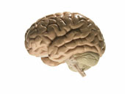

Techniques
Thumbwalking- most areas, primarily plantar surface of the foot
Finger roll- brain- distal toe- applied with pad of index finger
Finger walk- dorsal foot, applied with lateral edge of index finger
Hook in and pull back- pituitary, ileocecal valve, sigmoid flexure- applied with lateral edge of thumb, sinking in and hooking slightly
Rotate- spine, diaphragm, lymph drain

Slide 32
Reflex point locations 1-14
Spine- medial aspect of foot
  Cervical- base of big toenail to below joint
  Thoracic- below joint to waist
  Lumbar- waist to heel
  Sacrum- below heel
  Coccyx- middle heel
Brain- distal 1/3 of toes
Sinuses- middle 1/3 of toes
Temple- distal 3rd of big toes lateral

Slide 33
Reflex point locations 1-14
Side of the neck- proximal 2/3 of big toe lateral
Eye, inner ear- neck zones 2-3
Middle outer ear- neck zones 4-5
Nose – middle 3rd of toes
Mouth- proximal 3rd of toes
Throat- neck
Jaw- proximal 2/3 of toe, tmj little toe
Teeth gums- proximal 3rd of toes
Pituitary pineal- lateral center of big toes- peak
Thyroid parathyroids- neck

Slide 34
Homework
Color the 14 reflex points we learned so far on
your chart
Practice relaxation techniques, thumbwalking
and finger walking on points 1-14 and record the
clients reactions and your experience

Slide 35
Class 4 Objectives
Discuss the importance of working on the feet
Exploring the feet- what to look for
Possible reasons for Granular deposits
Review reflexology techniques and reflexes 1-14
on chart

Slide 36
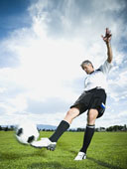

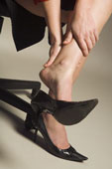
Why work the feet?
In use everyday for going places and daily tasks
Often neglected
Good substitute for massage when there are contraindications in other parts of the body
Accumulation of tension and debris from gravity
Anatomical relationship between feet and body simple and easy to understand

Slide 37
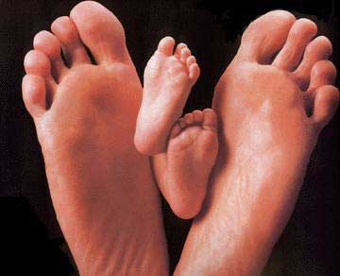
Exploring the Feet
It is important to careful inspect the feet and notice foot conditions
Temperature of different areas
Texture (soft and hard areas)
Bones
Muscles
Tendons
Foot Oder
Cracking in Tissues
Flexibility and mobility
Redness puffiness or swelling
Corns, calluses, cuts, bruises, rashes, etc

Slide 38

What Granular Deposits may be
When you feel areas of tension or deposits releasing them can improve circulation. Often these places are called “crystals” or “crunchies” by reflexologists. Here are some of the causes of these irregularities in the feet.
Solid acid build up such as lactic or uric acid due to trauma, overuse, poor nutrition, lack of oxygen, poor circulation
Injured, hardened or inflamed nerve endings
Tension or energy blocks
Tissue degeneration, adhesions or scabs
Pollutants, foreign particles, metallic or fatty accumulations and build up
Calcifications such as bone spurs

Slide 39
Reflex point locations 1-14
Spine- medial aspect of foot
  Cervical- base of big toenail to below joint
  Thoracic- below joint to waist
  Lumbar- waist to heel
  Sacrum- below heel
  Coccyx- middle heel
Brain- distal 1/3 of toes
Sinuses- middle 1/3 of toes
Temple- distal 3rd of big toes lateral

Slide 40
Reflex point locations 1-14
Side of the neck- proximal 2/3 of big toe lateral
Eye, inner ear- neck zones 2-3
Middle outer ear- neck zones 4-5
Nose – middle 3rd of toes
Mouth- proximal 3rd of toes
Throat- neck
Jaw- proximal 2/3 of toe, tmj little toe
Teeth gums- proximal 3rd of toes
Pituitary pineal- lateral center of big toes- peak
Thyroid parathyroids- neck

Slide 41
Homework
Draw points 1-14 on blank chart
Practice relaxation techniques, thumbwalking and finger walking on points 1-14 and record the clients reactions and your experience. Also record texture, color, deposits and other observations you discover.

Slide 42
Class 5 Objectives
Discuss special populations
Discuss possible client responses to treatment
Reflexology Technique: rotation on a point
Teach reflexes 15-31 on chart

Slide 43
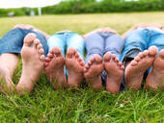
Who Reflexology Helps
Elderly
Children
Pregnant women
Overweight
Athletes
People who are often on their feet
People with foot problems
People under a lot of stress
Bedridden people

Slide 44
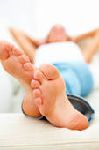
What clients may experience
Deep relaxation
Balance, centered, mentally clear
Revitalization
Light floaty feeling- endorphin release
Tingling or itchiness form improvement in nerve flow
Healing signs from toxin release- nausea, diarrhea, sinus drainage, emotional release

Slide 45
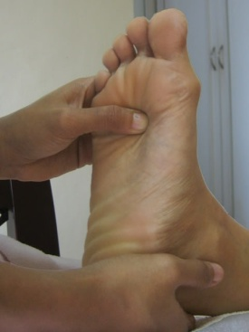
Techniques
Thumbwalking- most areas, primarily plantar surface of the foot
Finger roll- brain- distal toe- applied with pad of index finger
Finger walk- dorsal foot, applied with lateral edge of index finger
Hook in and pull back- pituitary, ileocecal valve, sigmoid flexure- applied with lateral edge of thumb, sinking in and hooking slightly
Rotate- spine, diaphragm, lymph drain

Slide 46
Reflexes 15-31
Esophagus- diaphragm to neckline, medial zone 1 left
Diaphram- diaphragm line zones 1-5
Solar Plexus- proximal to diaphragm, zone 2
Lung- Diaphram to neckline, zone 2-5 right, zones 1-2 left
Heart- diaphragm to neckline, zone 1 right, zones 1-2 left
Thymus- diaphragm to neckline, medial zone 1
Bronchial tube- diaphragm to neckline, between zones 1-2
Shoulder- Diaphragm to neckline, zone 5, between zones 4-5
Lymph Drain- Dorsal Metatarsals between zones 1-2, dorsal ankle

Slide 47
Reflexes 15-31
24. Ribs/ upper back- Diaphragm to neckline between metatarsals down to waistline
25. Breast- diaphragm to neckline, between zones 3-4
26. Liver- Waistline to diaphragm, zones -4 right, zone 1 left
27. Gall bladder- halfway between waistline and diaphragm, zone 4 right
28. Adrenal- waistline 1/3 to diaphragm, zones 1 left, zone 1 right
29. Stomach- waistline to diaphragm, zones 1-4 left, zone 1 right
30. Spleen- proximal to diaphragm, between zones 4-5, left
31. Pancreas- waistline halfway to diaphragm, zones 1-4 left, waistline

Slide 48
Homework
Color the 15-31 reflex points we learned so far on your chart
Practice relaxation techniques, thumbwalking and finger walking on points 15-31 and record the clients reactions and your experience

Slide 49
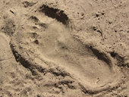
Class 6 Objectives
Discuss referral areas in the body
Go over primary and helper areas
Review reflexology techniques
Review reflexes 15-31 on chart

Slide 50
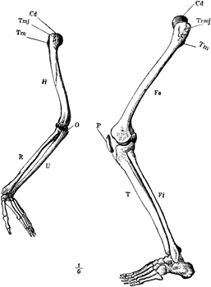
Referral areas
Upper back/lower back
Fingers/ toes
Shoulder/ hip
Upper arms/ Thigh
Elbow/knee
Forearm/leg
Wrist/ankle
Hands/foot
Thumbs/ big toe

Slide 51
Primary and helper areas
Primary/ direct – specific condition
Secondary/ helper- aid and reinforce healing

Slide 52
Reflexes 15-31
Esophagus- diaphragm to neckline, medial zone 1 left
Diaphram- diaphragm line zones 1-5
Solar Plexus- proximal to diaphragm, zone 2
Lung- Diaphram to neckline, zone 2-5 right, zones 1-2 left
Heart- diaphragm to neckline, zone 1 right, zones 1-2 left
Thymus- diaphragm to neckline, medial zone 1
Bronchial tube- diaphragm to neckline, between zones 1-2
Shoulder- Diaphragm to neckline, zone 5, between zones 4-5
Lymph Drain- Dorsal Metatarsals between zones 1-2, dorsal ankle

Slide 53
Reflexes 15-31
24. Ribs/ upper back- Diaphragm to neckline between metatarsals down to waistline
25. Breast- diaphragm to neckline, between zones 3-4
26. Liver- Waistline to diaphragm, zones -4 right, zone 1 left
27. Gall bladder- halfway between waistline and diaphragm, zone 4 right
28. Adrenal- waistline 1/3 to diaphragm, zones 1 left, zone 1 right
29. Stomach- waistline to diaphragm, zones 1-4 left, zone 1 right
30. Spleen- proximal to diaphragm, between zones 4-5, left
31. Pancreas- waistline halfway to diaphragm, zones 1-4 left, waistline

Slide 54
Homework
Draw 15-31 reflex points we learned so far on your chart
Practice relaxation techniques, thumbwalking and finger walking on points 15-31 and record the clients reactions and your experience

Slide 55
Class 7 Objectives
Discuss professional ethics for Reflexologists
Review common foot problems handout
Reflexology for specific reflexes and common ailments
Teach reflexes 32- 50 on chart

Slide 56
Professional Ethics
Training
Public safety
Standards of practice
Consult medical professional
Self –care
( review code of ethics)

Slide 57
Reflexology referral areas for specific conditions
Reminder: “Do not diagnose, prescribe or claim to treat specific conditions”
Constipation- liver, gallbladder, diaphragm, adrenals, lower spine, sigmoid, illeocecal
Diarrhea- ascending colon, transverse colon, diaphragm, liver, adrenals
Insomnia- diaphragm, call glands
Edema- lymph system, kidneys, adrenals
Tinnitus- ear reflex, cervical, neck , great toe
Headache- whole spine, diaphragm, all glands, toes
Cramps- hip/knee, sciatic, lower spine, parathyroid, adrenals
Sprain- specific area, referral area

Slide 58
Reflexology points 32- 50
Illeocecal Valve- medial of cuboid notch between zones 4-5 right
Ascending colon- heel line to waistline, between zones 4-5 right
Hepatic Flexure- waistline, zone 4 right
Transverse colon- waistline, zones 1-4
Splenic Flexure- waistline, zone 4 left
Descending Colon- waistline to heel line, between zones 4-5, left
Sigmoid colon- mid heel, between zones 3-4, left
Small Intestines- heel line to waistline, zones 1-4
Kidney- above, on and below waistline, medial tendon

Slide 59
Reflexology points 32- 50
Ureter tube- heel line to waistline, medial tendon
Bladder/ Sacroilliac joint- heel line, medial
Sciatic – lower heel, zones 1-5
Uterus/Prostate- halfway between heel and ankle, medial
Ovary /teste- halfway between heel and ankle, lateral
Fallopian Tube/ lymph Drain- dorsal ankle
Chronic area- medial aspect of leg, spleen 6 point to medial heel
Arm/hand- waistline to diaphragm line lateral
Hip/ Knee /Leg- cuboid notch triangle, lateral
Hip / Sciatic- posterior to lateral anklebone

Slide 60
Homework
Color the 31-50 reflex points we learned so far on your chart
Practice relaxation techniques, thumbwalking and finger walking on points 31-50 and record the clients reactions and your experience

Slide 61
Class 8 Objectives
Review reflexology techniques and application
Overview of hand and ear reflexology
Review reflexes 1-50 on chart
Answer questions

Slide 62
Techniques
Thumbwalking- most areas, primarily plantar surface of the foot
Finger roll- brain- distal toe
Finger walk- dorsal foot
Hook in and pull back- pituitary, ileocecal valve, sigmoid flexure
Rotate- spine, diaphragm, lymph drain

Slide 63
Class 9 Objectives
Review reflexes
Part 1 written exam
Practical exam 1 hour session 1 partner

Slide 64
Class 10 Objectives
Part 2 written exam
Practical exam 1 hour session 1 partner

