Slide 1

Reflexology Tips for the Neck, Spine, Hips, and Shoulders
Heather Han, LMT, MSCP

Slide 2
Course Description
Students completing this course will be able to understand the basic theory of reflexology, guidelines on the feet, joint mobilization techniques for the feet, and the locations of the corresponding reflex points on the feet for the for the neck, spine hips and shoulders.

Slide 3
What is Reflexology?
A manual therapy focusing on reflex points of the hands, ears and feet that affects the whole body.
Pressure on the feet and hands affects all organs glands and parts of the body. The main effects are bringing the body to balance or homeostasis, relaxation, and circulation. Reflexology improves circulation of blood and energy and stimulates the parasympathetic nervous system
How does Reflexology Work?

Slide 4
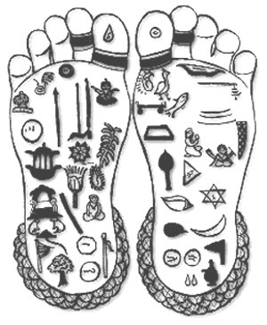
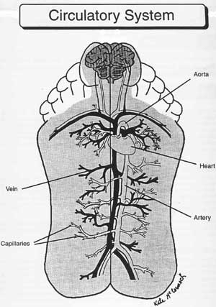
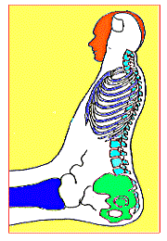
Feet, Hands and Ears as map of the body

Slide 5
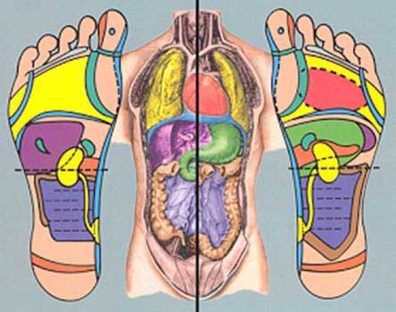
Feet, Hands and Ears as map of the body

Slide 6
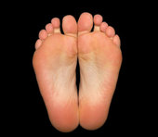
Identify Landmarks of the Feet
Base of toes- neck line
Diaphragm – below ball of foot
Waist- base of fifth metatarsal
Heel-pelvic line
Spine
5 zones on each foot

Slide 7
50- Point Chart

Slide 8
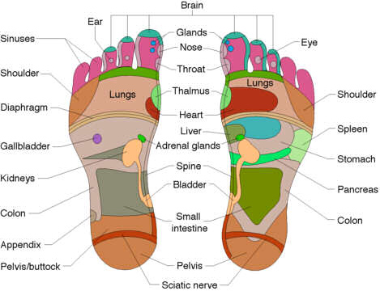

Slide 9
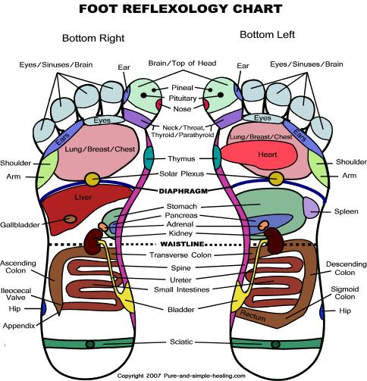

Slide 10
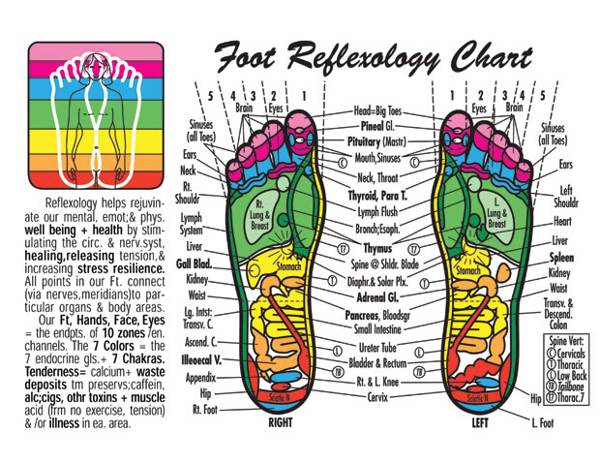

Slide 11
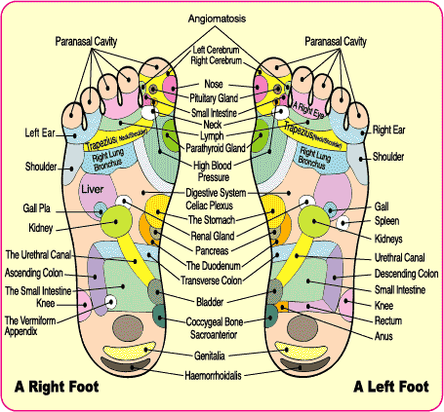

Slide 12
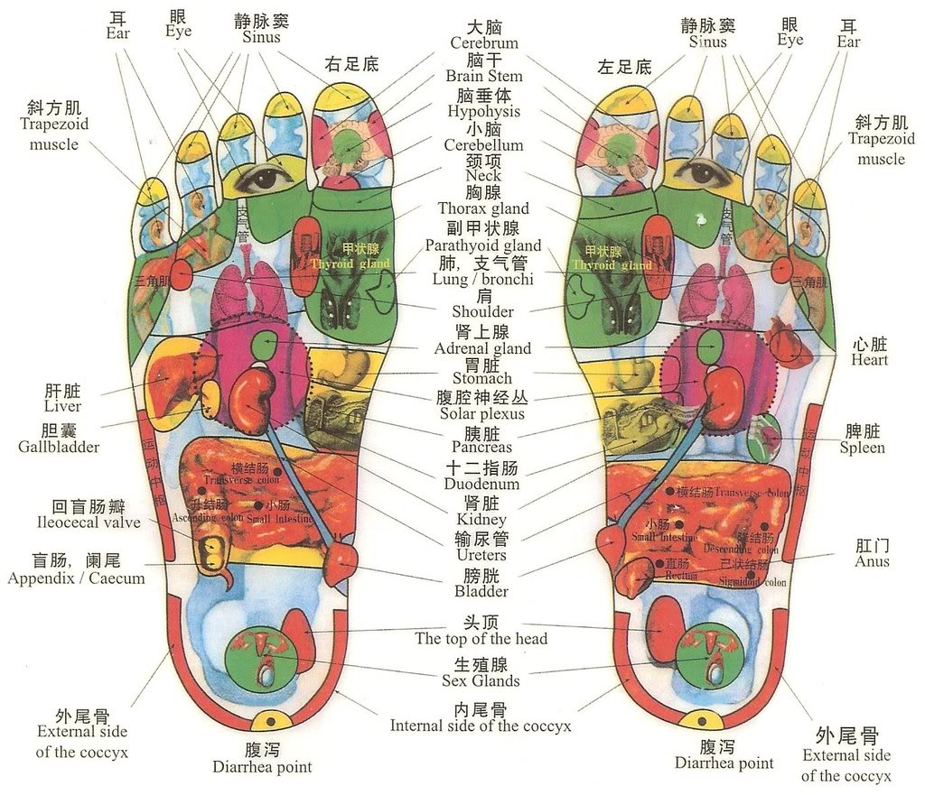

Slide 13
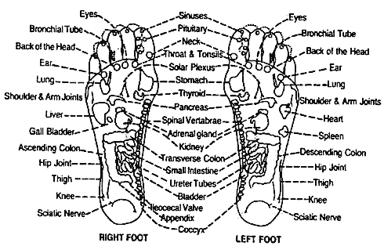

Slide 14
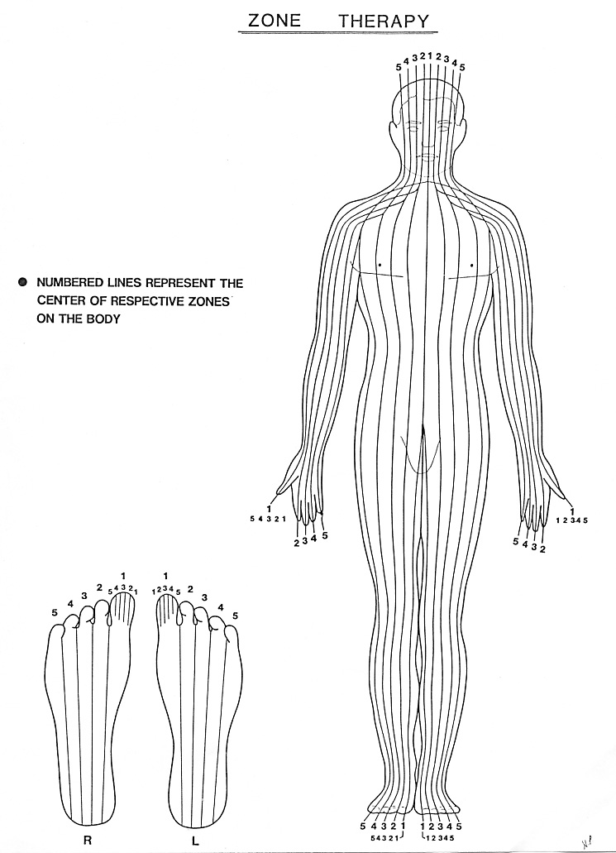
Zone Therapy
Zone therapy- what happens in one part of Zone it can affect any organ or gland in that Zone, viewed as simplified meridian system

Slide 15
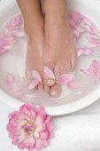
Foot Relaxation
Ankle range of motion – dorsiflexion, plantarflexion
Ankle rotation- hand on dorsal, hand on heel
Foot side to side shake
Ankle side to side shake
Toe side to side shake
toe rotation
Spinal Twist (medial)
Metatarsal press (plantar)
Metatarsal roll
Foot pinching (lateral)
Diaphragm tension relaxer

Slide 16

Techniques
Thumbwalking- most areas, primarily plantar
surface of the foot
Rotate

Slide 17
Reflexology on the Spine
Spine- medial aspect of foot
  Cervical- base of big toenail to below joint
  Thoracic- below joint to waist
  Lumbar- waist to heel
  Sacrum- below heel
  Coccyx- middle heel

Slide 18
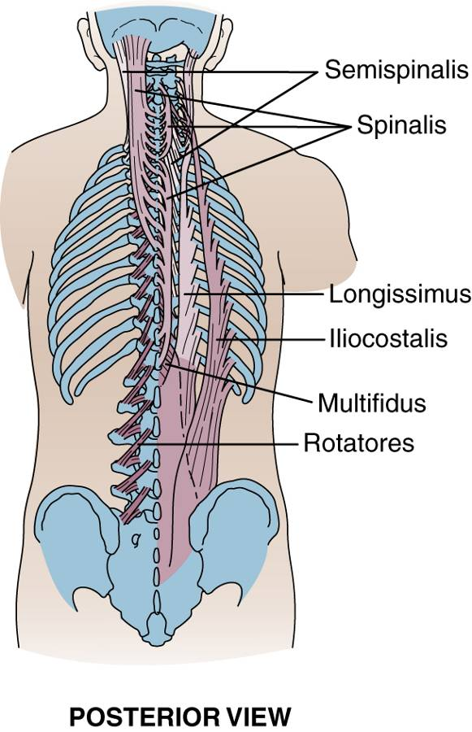

Slide 19
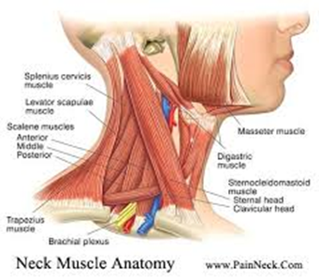
Reflexology on the Neck

Slide 20
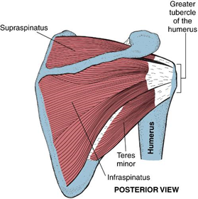
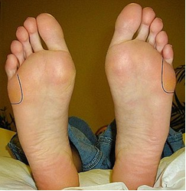
Reflexology on the Shoulders

Slide 21
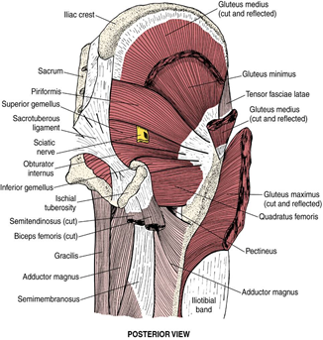
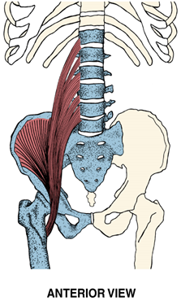
Reflexology on the Hip

Slide 22
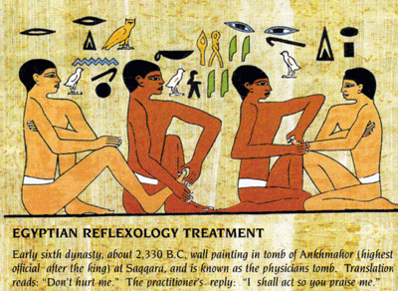

Slide 23
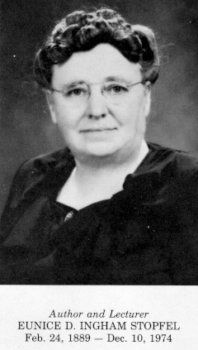

Eunice Ingham and Dwight Byers

Slide 24
Techniques
Thumbwalking- most areas, primarily plantar
surface of the foot
It inches forward not backward or side to side
Constant pressure applied with lateral edge of
the thumb
Thumb remains slightly bent while moving
forward
Support foot with holding hand

Slide 25
Guidelines for treatment
Wash hands, trim nails, watch posture, relax, breath, stay grounded
Take medical history
For client – no stimulants, depressants or heavy meals before session
Medication alcohol or drugs may reduce sensitivity
More relaxation and less pressure for first session
For sore areas go to pain threshold, work other areas and come back, work from different directions
Answer questions in general terms
Encourage rest after the session

Slide 26
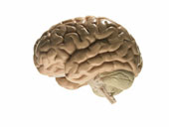

Techniques
Thumbwalking- most areas, primarily plantar surface of the foot
Finger roll- brain- distal toe- applied with pad of index finger
Finger walk- dorsal foot, applied with lateral edge of index finger
Hook in and pull back- pituitary, ileocecal valve, sigmoid flexure- applied with lateral edge of thumb, sinking in and hooking slightly
Rotate- spine, diaphragm, lymph drain

Slide 27
Reflex point locations 1-14
Spine- medial aspect of foot
  Cervical- base of big toenail to below joint
  Thoracic- below joint to waist
  Lumbar- waist to heel
  Sacrum- below heel
  Coccyx- middle heel
Brain- distal 1/3 of toes
Sinuses- middle 1/3 of toes
Temple- distal 3rd of big toes lateral

Slide 28
Reflex point locations 1-14
Side of the neck- proximal 2/3 of big toe lateral
Eye, inner ear- neck zones 2-3
Middle outer ear- neck zones 4-5
Nose – middle 3rd of toes
Mouth- proximal 3rd of toes
Throat- neck
Jaw- proximal 2/3 of toe, tmj little toe
Teeth gums- proximal 3rd of toes
Pituitary pineal- lateral center of big toes- peak
Thyroid parathyroids- neck

Slide 29
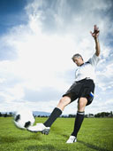

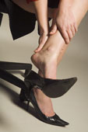
Why work the feet?
In use everyday for going places and daily tasks
Often neglected
Good substitute for massage when there are contraindications in other parts of the body
Accumulation of tension and debris from gravity
Anatomical relationship between feet and body simple and easy to understand

Slide 30
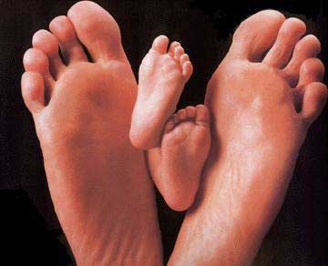
Exploring the Feet
It is important to careful inspect the feet and notice foot conditions
Temperature of different areas
Texture (soft and hard areas)
Bones
Muscles
Tendons
Foot Oder
Cracking in Tissues
Flexibility and mobility
Redness puffiness or swelling
Corns, calluses, cuts, bruises, rashes, etc

Slide 31

What Granular Deposits may be
When you feel areas of tension or deposits releasing them can improve circulation. Often these places are called “crystals” or “crunchies” by reflexologists. Here are some of the causes of these irregularities in the feet.
Solid acid build up such as lactic or uric acid due to trauma, overuse, poor nutrition, lack of oxygen, poor circulation
Injured, hardened or inflamed nerve endings
Tension or energy blocks
Tissue degeneration, adhesions or scabs
Pollutants, foreign particles, metallic or fatty accumulations and build up
Calcifications such as bone spurs

Slide 32
Reflex point locations 1-14
Spine- medial aspect of foot
  Cervical- base of big toenail to below joint
  Thoracic- below joint to waist
  Lumbar- waist to heel
  Sacrum- below heel
  Coccyx- middle heel
Brain- distal 1/3 of toes
Sinuses- middle 1/3 of toes
Temple- distal 3rd of big toes lateral

Slide 33
Reflex point locations 1-14
Side of the neck- proximal 2/3 of big toe lateral
Eye, inner ear- neck zones 2-3
Middle outer ear- neck zones 4-5
Nose – middle 3rd of toes
Mouth- proximal 3rd of toes
Throat- neck
Jaw- proximal 2/3 of toe, tmj little toe
Teeth gums- proximal 3rd of toes
Pituitary pineal- lateral center of big toes- peak
Thyroid parathyroids- neck

Slide 34
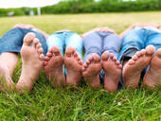
Who Reflexology Helps
Elderly
Children
Pregnant women
Overweight
Athletes
People who are often on their feet
People with foot problems
People under a lot of stress
Bedridden people

Slide 35
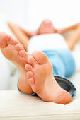
What clients may experience
Deep relaxation
Balance, centered, mentally clear
Revitalization
Light floaty feeling- endorphin release
Tingling or itchiness form improvement in nerve flow
Healing signs from toxin release- nausea, diarrhea, sinus drainage, emotional release

Slide 36
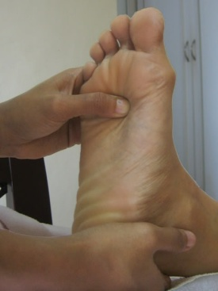
Techniques
Thumbwalking- most areas, primarily plantar surface of the foot
Finger roll- brain- distal toe- applied with pad of index finger
Finger walk- dorsal foot, applied with lateral edge of index finger
Hook in and pull back- pituitary, ileocecal valve, sigmoid flexure- applied with lateral edge of thumb, sinking in and hooking slightly
Rotate- spine, diaphragm, lymph drain

Slide 37
Reflexes 15-31
Esophagus- diaphragm to neckline, medial zone 1 left
Diaphram- diaphragm line zones 1-5
Solar Plexus- proximal to diaphragm, zone 2
Lung- Diaphram to neckline, zone 2-5 right, zones 1-2 left
Heart- diaphragm to neckline, zone 1 right, zones 1-2 left
Thymus- diaphragm to neckline, medial zone 1
Bronchial tube- diaphragm to neckline, between zones 1-2
Shoulder- Diaphragm to neckline, zone 5, between zones 4-5
Lymph Drain- Dorsal Metatarsals between zones 1-2, dorsal ankle

Slide 38
Reflexes 15-31
24. Ribs/ upper back- Diaphragm to neckline between metatarsals down to waistline
25. Breast- diaphragm to neckline, between zones 3-4
26. Liver- Waistline to diaphragm, zones -4 right, zone 1 left
27. Gall bladder- halfway between waistline and diaphragm, zone 4 right
28. Adrenal- waistline 1/3 to diaphragm, zones 1 left, zone 1 right
29. Stomach- waistline to diaphragm, zones 1-4 left, zone 1 right
30. Spleen- proximal to diaphragm, between zones 4-5, left
31. Pancreas- waistline halfway to diaphragm, zones 1-4 left, waistline

Slide 39
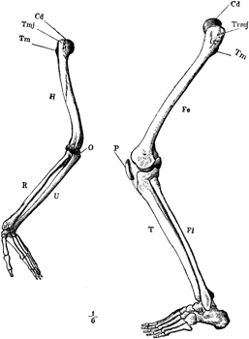
Referral areas
Upper back/lower back
Fingers/ toes
Shoulder/ hip
Upper arms/ Thigh
Elbow/knee
Forearm/leg
Wrist/ankle
Hands/foot
Thumbs/ big toe

Slide 40
Primary and helper areas
Primary/ direct – specific condition
Secondary/ helper- aid and reinforce healing

Slide 41
Reflexes 15-31
Esophagus- diaphragm to neckline, medial zone 1 left
Diaphram- diaphragm line zones 1-5
Solar Plexus- proximal to diaphragm, zone 2
Lung- Diaphram to neckline, zone 2-5 right, zones 1-2 left
Heart- diaphragm to neckline, zone 1 right, zones 1-2 left
Thymus- diaphragm to neckline, medial zone 1
Bronchial tube- diaphragm to neckline, between zones 1-2
Shoulder- Diaphragm to neckline, zone 5, between zones 4-5
Lymph Drain- Dorsal Metatarsals between zones 1-2, dorsal ankle

Slide 42
Reflexes 15-31
24. Ribs/ upper back- Diaphragm to neckline between metatarsals down to waistline
25. Breast- diaphragm to neckline, between zones 3-4
26. Liver- Waistline to diaphragm, zones -4 right, zone 1 left
27. Gall bladder- halfway between waistline and diaphragm, zone 4 right
28. Adrenal- waistline 1/3 to diaphragm, zones 1 left, zone 1 right
29. Stomach- waistline to diaphragm, zones 1-4 left, zone 1 right
30. Spleen- proximal to diaphragm, between zones 4-5, left
31. Pancreas- waistline halfway to diaphragm, zones 1-4 left, waistline

Slide 43
Professional Ethics
Training
Public safety
Standards of practice
Consult medical professional
Self –care
( review code of ethics)

Slide 44
Reflexology referral areas for specific conditions
Reminder: “Do not diagnose, prescribe or claim to treat specific conditions”
Constipation- liver, gallbladder, diaphragm, adrenals, lower spine, sigmoid, illeocecal
Diarrhea- ascending colon, transverse colon, diaphragm, liver, adrenals
Insomnia- diaphragm, call glands
Edema- lymph system, kidneys, adrenals
Tinnitus- ear reflex, cervical, neck , great toe
Headache- whole spine, diaphragm, all glands, toes
Cramps- hip/knee, sciatic, lower spine, parathyroid, adrenals
Sprain- specific area, referral area

Slide 45
Reflexology points 32- 50
Illeocecal Valve- medial of cuboid notch between zones 4-5 right
Ascending colon- heel line to waistline, between zones 4-5 right
Hepatic Flexure- waistline, zone 4 right
Transverse colon- waistline, zones 1-4
Splenic Flexure- waistline, zone 4 left
Descending Colon- waistline to heel line, between zones 4-5, left
Sigmoid colon- mid heel, between zones 3-4, left
Small Intestines- heel line to waistline, zones 1-4
Kidney- above, on and below waistline, medial tendon

Slide 46
Reflexology points 32- 50
Ureter tube- heel line to waistline, medial tendon
Bladder/ Sacroilliac joint- heel line, medial
Sciatic – lower heel, zones 1-5
Uterus/Prostate- halfway between heel and ankle, medial
Ovary /teste- halfway between heel and ankle, lateral
Fallopian Tube/ lymph Drain- dorsal ankle
Chronic area- medial aspect of leg, spleen 6 point to medial heel
Arm/hand- waistline to diaphragm line lateral
Hip/ Knee /Leg- cuboid notch triangle, lateral
Hip / Sciatic- posterior to lateral anklebone

Slide 47
Techniques
Thumbwalking- most areas, primarily plantar surface of the foot
Finger roll- brain- distal toe
Finger walk- dorsal foot
Hook in and pull back- pituitary, ileocecal valve, sigmoid flexure
Rotate- spine, diaphragm, lymph drain

